Slide 1

EE005 DSAI Group 8
Cardiovascular Disease Prediction
Members:
Than Duc Huy
Nguyen Hoang Minh
Low Thien Shawn
Ling Zijie
Tan Xin Lin

Slide 2

1
Problem Statement
2
Data Processing and Analysis
Shawn & Zijie
Content
3
Clustering
Xin Lin
4
Classification Model
Minh
5
Mini Web Application
Huy

Slide 3
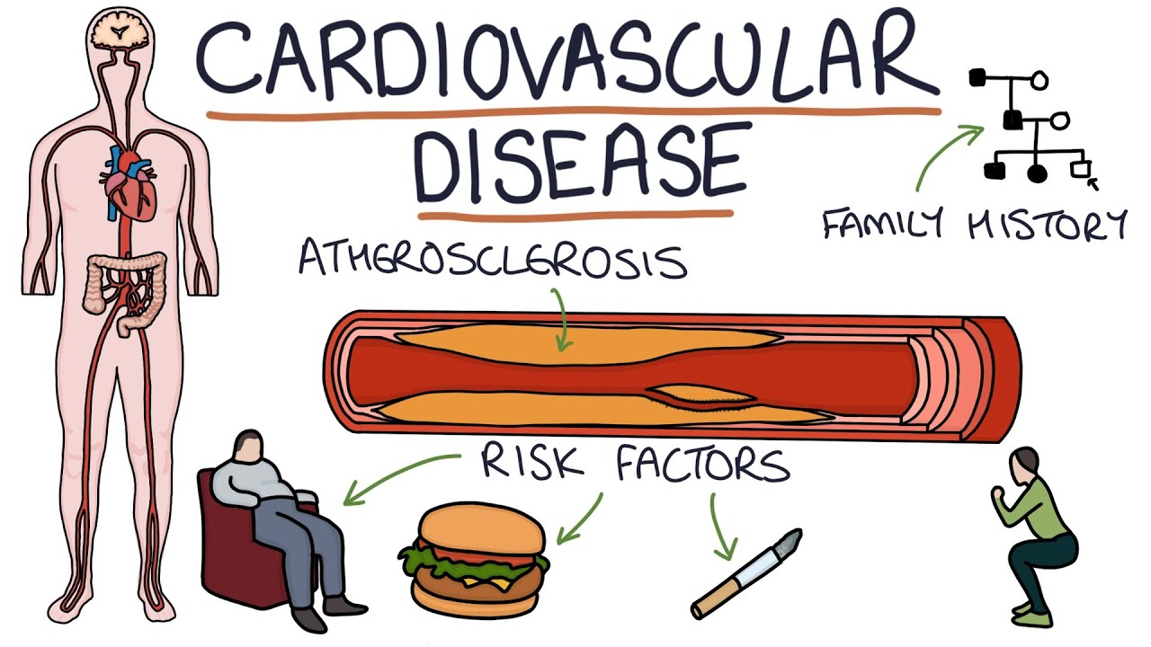
Problem Statement
Problem: Cardiovascular disease accounted for 31.7% of all deaths in 2020 in Singapore (19 people die from these disease every day)
Solution: Early detection to prevent stroke, heart failure and further complications
Application: Mini web application that predicts the risk of having the disease of an individual
Photo from Youtube: https://www.youtube.com/watch?v=qJq5hA4pnOk

Slide 4

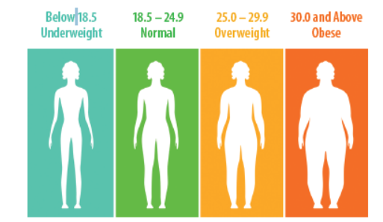
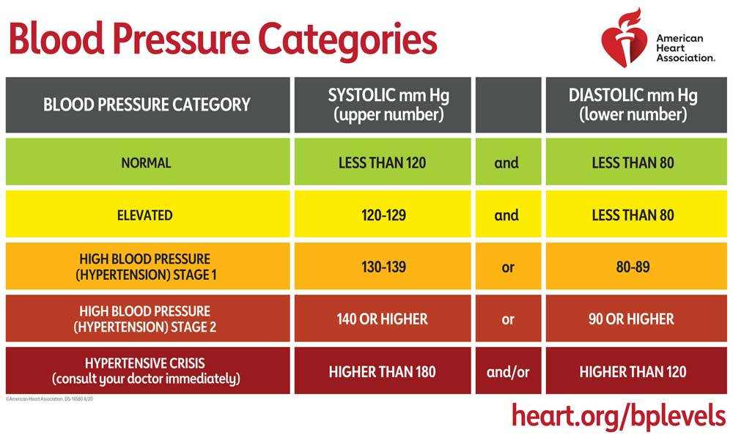
Data Processing
Derivatives features used by professionals
Systolic: blood pressure when heart is pumping
Diastolic: blood pressure when heart at rest
Photo from Tuft University: “What, exactly, is BMI?”
Photo from heart.org

Slide 5
Data Processing
Raw Data
Processed Data
Numerical
Age
In years
Height
Weight
Body Mass Index (BMI)
Range [10, 80]
Systolic blood pressure (ap_hi)
Range [40, 200]
Diastolic blood pressure (ap_lo)
Range [40, 140]
Categorical
Obesity
Blood Pressure Categories
Gender
Cholesterol
Glucose
Smoke
Alcohol
Being active
Target: Presence of disease (cardio)
Conversion
Numerical
Age
In days
Height
Weight
Systolic blood pressure (ap_hi)
Range [-150, 16020]
Diastolic blood pressure (ap_lo)
Range [-70, 11000]
Categorical
Gender
Cholesterol
Glucose
Smoke
Alcohol
Being active
Target: Presence of disease (cardio)
Feature Engineering, Filter humanly possible range
Filter humanly possible range
Feature Engineering

Slide 6
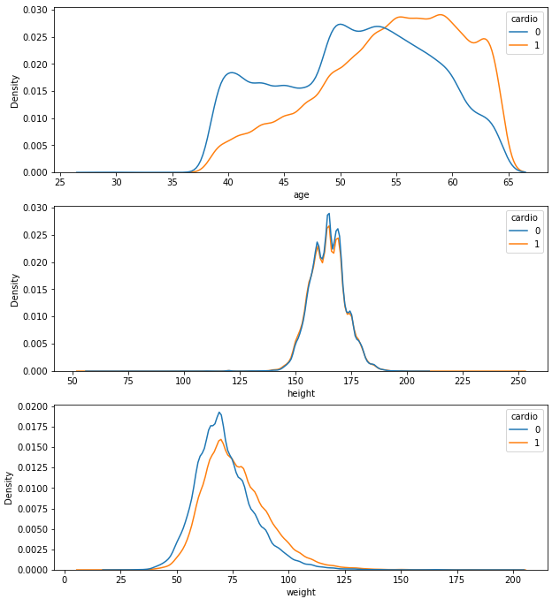
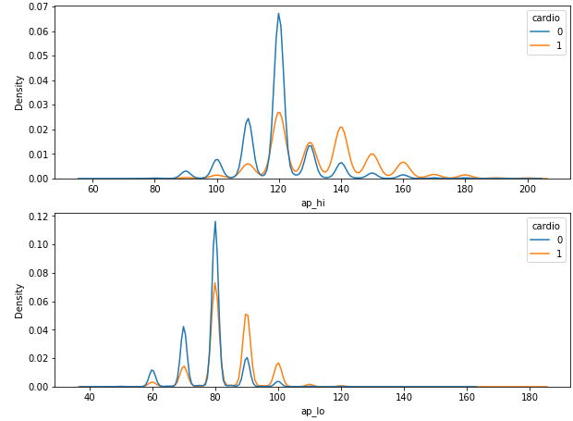
Data Analysis: Numerical Features
Height, weight: overlapping distribution

Slide 7
Data Analysis: Numerical Features
Height and weight: overlapping distribution
Age: Positive correlation
Notes:
Patients who have Systolic blood pressure higher than 130mmHg or Diastolic blood pressure higher than 85mmHg are more exposed to CVDs.

Slide 8
Data Analysis: Numerical Features
Height and weight: overlapping distribution
Age: Positive correlation
Ap_hi, Ap_lo: Positive correlation

Slide 9
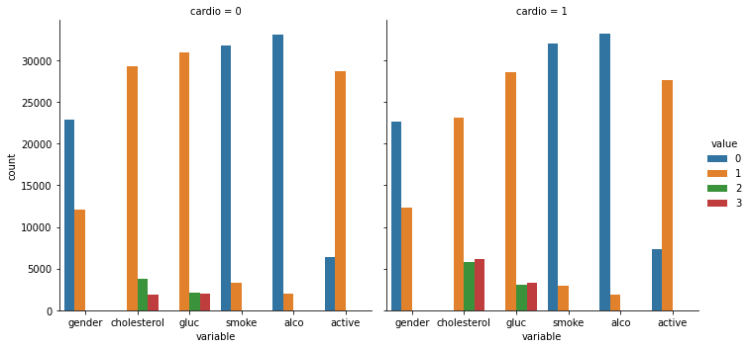
Data Analysis: Categorical Features
No disease
With Disease
Female
Male
Female
Male
Balanced data for cardio feature (# without disease ≈ # with disease)
More female than male

Slide 10
Data Analysis: Categorical Features
No disease
With Disease
Female
Male
Female
Male
Higher ratio of above normal and well above normal Cholesterol and Glucose level with disease
Positive correlation

Slide 11
Data Analysis: Categorical Features
No disease
With Disease
Female
Male
Female
Male
Higher ratio of above normal and well above normal Cholesterol and Glucose level with disease
Positive correlation
Higher ratio of not active with disease
Negative correlation

Slide 12
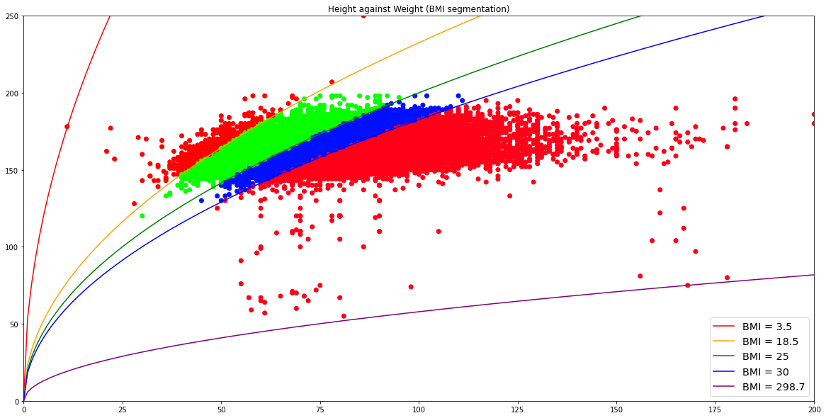
Categorical Separation
Threshold separation
Separation by analytical (quadratic) function

Slide 13
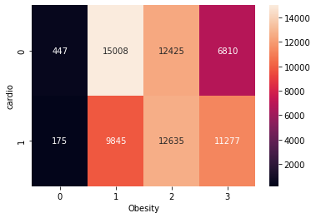
BMI Usefulness
Underweight
Healthy
Overweight
Obese
For the underweight and healthy, the majority don't have disease
Notes:
# -
# - For overweight people, the number of people having and not having disease is comparable
# - For obese people, the majority has disease.

Slide 14
BMI Usefulness
Underweight
Healthy
Overweight
Obese
For the underweight and healthy, the majority don't have disease
For the overweight, the number of people having and not having disease is comparable
Notes:
# -
# -
# - For obese people, the majority has disease.

Slide 15
BMI Usefulness
Underweight
Healthy
Overweight
Obese
For the underweight and healthy, the majority don't have disease
For the overweight, the number of people having and not having disease is comparable
For the obese, the majority has disease
Positive correlation
Notes:
# -
# -
# -

Slide 16
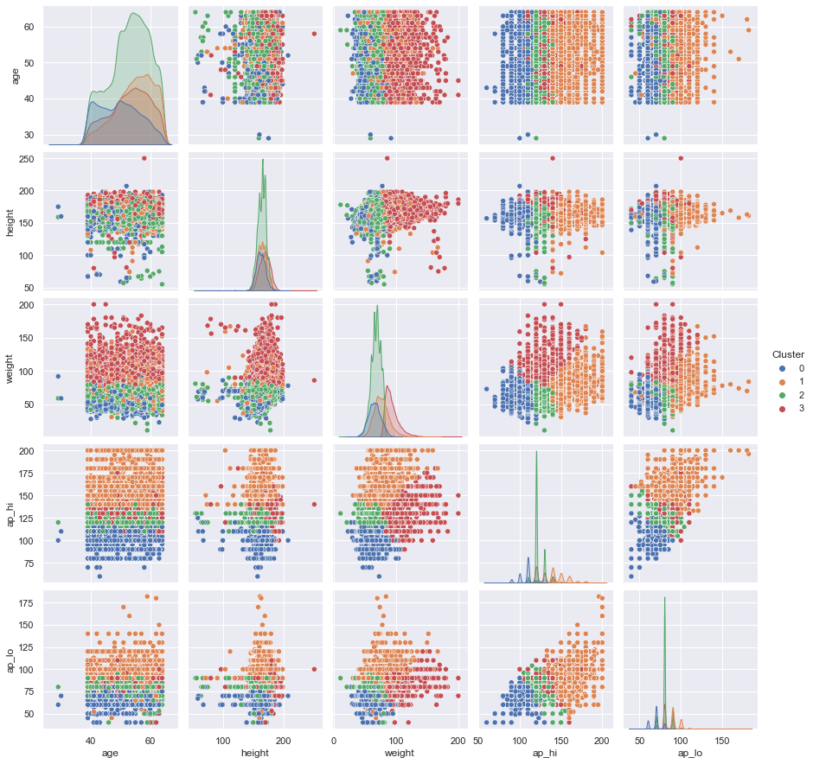
Kmean Multi-Variate Clustering
Threshold & Quadratic are relatively straightforward and simple pattern
Machine Learning clustering methods (such as Kmean) take advantage of large quantity and multivariate (multi-dimension) data
However, we are not medical professional to validate the cluster relevance
Kmean clustering on numerical features

Slide 17
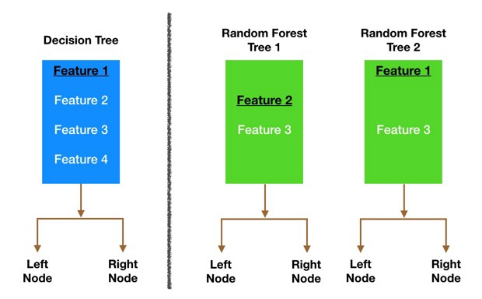
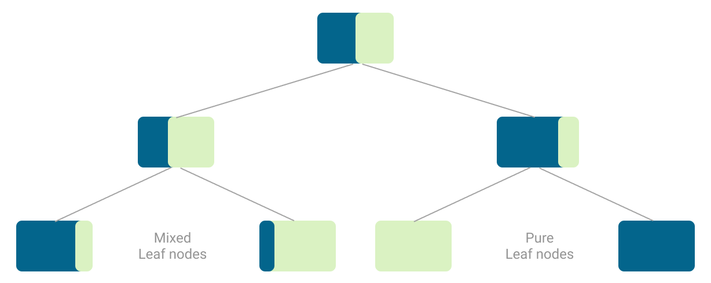
Classification Models
List of models: Decision Tree, Random Forest, Ada Boost, Gradient Boost
Decision Tree
Random Forest
Notes:
For the machine learning part, we were testing on 4 different models which are Decision Tree, Random Forest, AdaBoost, Gradient Boosting.
These models have the decision tree as a primary building block in common.

Slide 18
Classification Models
List of models: Decision Tree, Random Forest, Ada Boost, Gradient Boost
Decision Tree
Random Forest
Create a large number of trees using:
Bagging (from sample or repeated data points)
Feature Randomness (from a few randomly selected features)
A large number of relatively uncorrelated trees operating as a committee will outperform any of the individual constituent models.
Notes:
For the machine learning part, we were testing on 4 different models which are Decision Tree, Random Forest, AdaBoost, Gradient Boosting.
These models have the decision tree as a primary building block in common.
Roughly speaking, the intuition behind Decision Trees is that we use the dataset features to create yes/no questions and continually split the dataset until we isolate all data points belonging to each class.
And the Random Forest Classifier is an algorithm which consists of many decisions trees. It uses bagging and feature randomness when building each individual tree to try to create an uncorrelated forest of trees whose prediction by committee is more accurate than that of any individual tree.
Bagging is the process of allowing each individual tree to randomly sample from the dataset with replacement, resulting in different trees.
Feature Randomness is the process of picking predictors only from a random subset of features. This forces even more variation amongst the trees in the model and ultimately results in lower correlation across trees and more diversification.
The AdaBoost and Gradient Boosting algorithm have very similar idea, which is: the subsequent trees help us to classify observations that are not well classified by the previous trees.

Slide 19
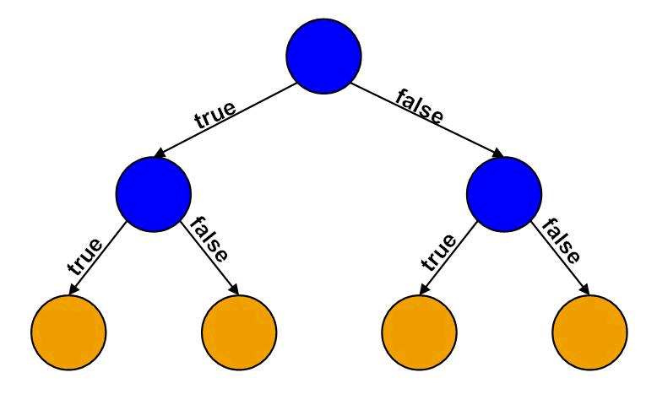
Classification Models
Why Decision Tree-based models?
Interpretability of Tree Models
Not much pre-processing required
Data Robustness: handle various type of data
Notes:
So the reason why we choose decision tree-based models is because of these following three points:
Interpretability you can visualize the decision tree.
No preprocessing required you don’t need to prepare the data before building the model.
Data robustness the algorithm handles all types of data nicely.

Slide 20
Performance Measures
Using grid-search to find the best combination of hyper-parameters for each model
Model | Accuracy |  | ROC AUC
 | Train set | Test set | Train Set | Test Set
AdaBoost | 73.20% | 72.61% | 73.12% | 72.65%
Decision Tree | 73.42% | 72.37% | 73.36% | 72.38%
Gradient Boosting | 74.10% | 73.15% | 74.05% | 73.13%
Random Forest | 74.52% | 73.04% | 74.46% | 73.02%
Notes:
This is the result we obtain from the best performance of each models.
The metrics we use to optimize a model is the Area Under Receiver Operating Characteristics Curve.
From the table, we can see that Random Forest Classifier is the best model among these.
We used grid search technique to find the best combination of hyper-parameters for each model but we couldn’t get an accuracy higher than 75%.
And we believe that the biggest reason for this is that the data isn’t sampled in a way that represents the users and some of them even inaccurate.

Slide 21
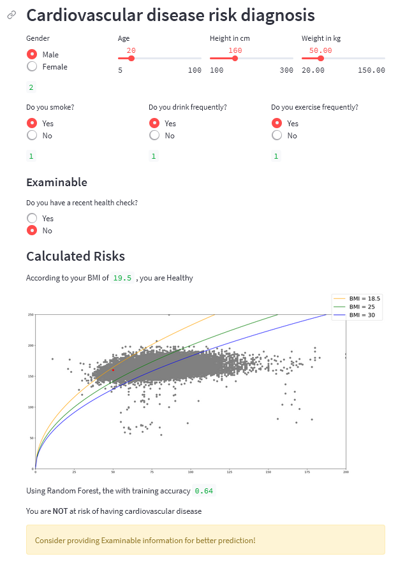
Mini Web Application
Streamlit:
Python library to create interactive web application and deployment
Users interact with application, not models
Demonstration at the end
Notes:
User interact by giving the necessary information for the model to predict

Slide 22
Conclusion & Discussion
The project allow us to understand the full pipeline of a data science, machine learning project from problem formulation to end product.
Discussion between cleaning data and manipulate data
When we clean data to optimize for accuracy of model, we might introduce our own bias
Data given is the sample, and not the whole population. Outliers are inevitable
The data are rudimentary, cannot fully predict disease. Human expertise and more features are required.
Prediction is useful to alert risky patients to seek further medical advice

Slide 23

Demonstration
https://share.streamlit.io/than-duc-huy/cardiovascular-disease/main/Main.py

